Slide 1

CHAPTER 9
COUNTING AND
PROBABILITY
Copyright © Cengage Learning. All rights reserved.

Slide 2
SECTION 9.8
Probability Axioms and Expected Value
Copyright © Cengage Learning. All rights reserved.

Slide 3
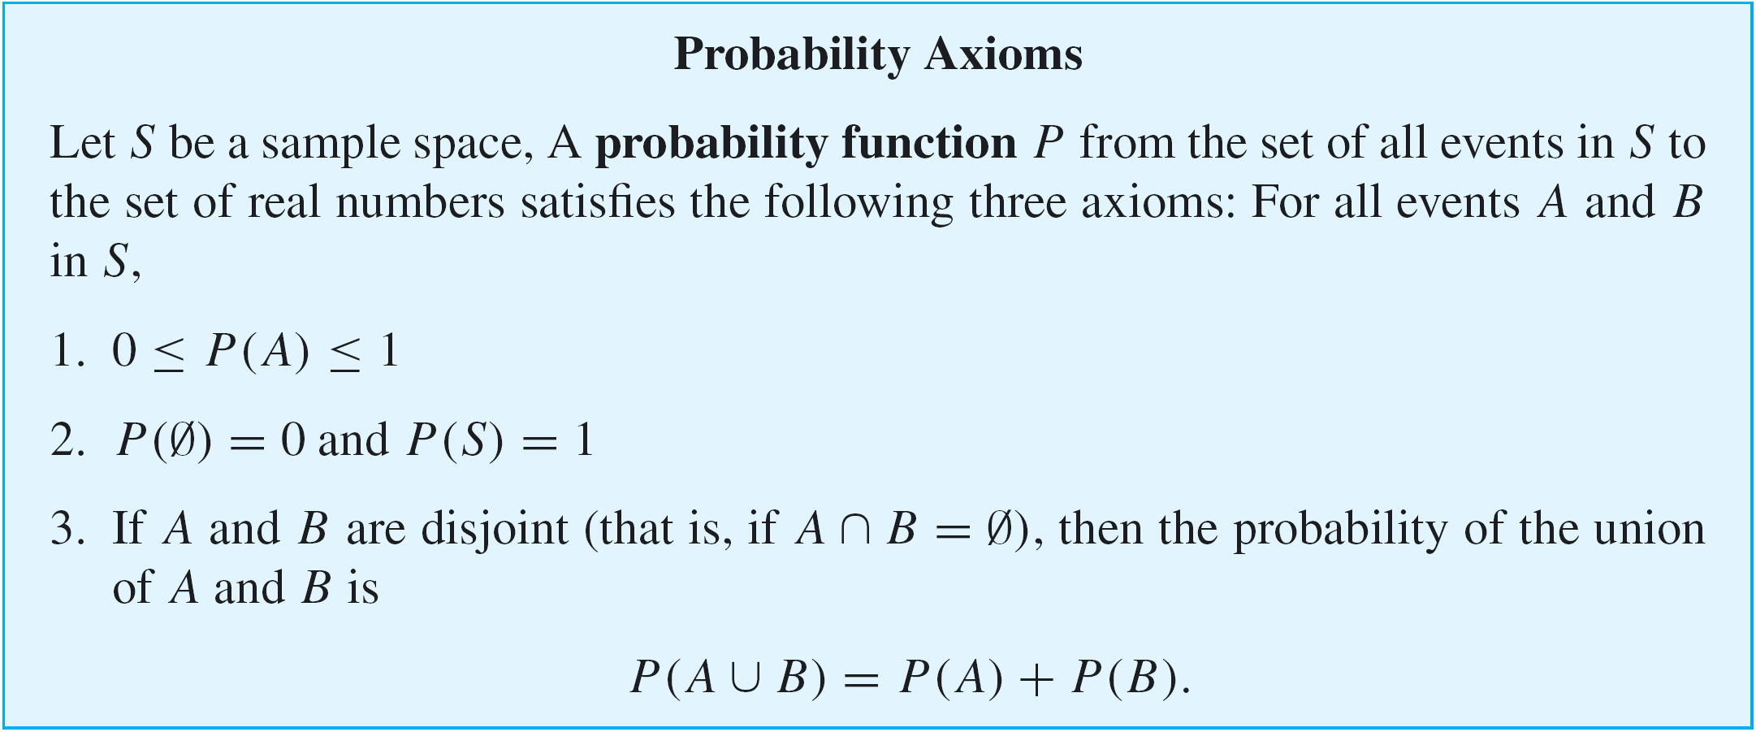
Probability Axioms and Expected Value
We have known that a sample space is a set of all outcomes of a random process or experiment and that an event is a subset of a sample space.

Slide 4
Example 2 – The Probability of the Complement of an Event
Suppose that A is an event in a sample space S. Deduce that P(A^{c}) = 1 – P(A).
Solution:
By Theorem 6.2.2(5),
Complement Laws:
(a) A ∪ A^{c} = U and (b) A ∩ A^{c} = ∅.
with S playing the role of the universal set U,
A ∩ A^{c} = ∅ and A ∪ A^{c} = S.

Slide 5
Example 2 – Solution
cont’d
Thus S is the disjoint union of A and A^{c}, and so
P(A ∪ A^{c}) = P(A) + P(A^{c}) = P(S) = 1.
Subtracting P(A) from both sides gives the result that
P(A^{c}) = 1 – P(A).

Slide 6
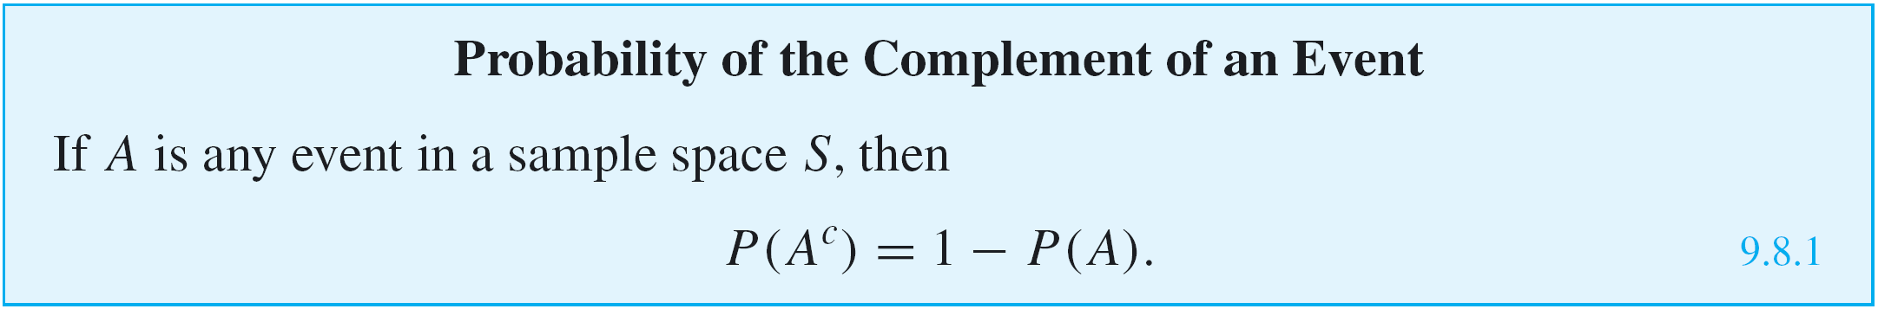
Probability Axioms and Expected Value
It is important to check that Kolmogorov’s probability axioms are consistent with the results obtained using the equally likely probability formula.

Slide 7

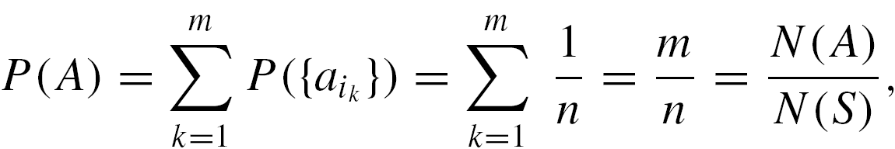
Probability Axioms and Expected Value
It follows that if A is any event with outcomes
, then
which is the result given by the equally likely probability formula.

Slide 8
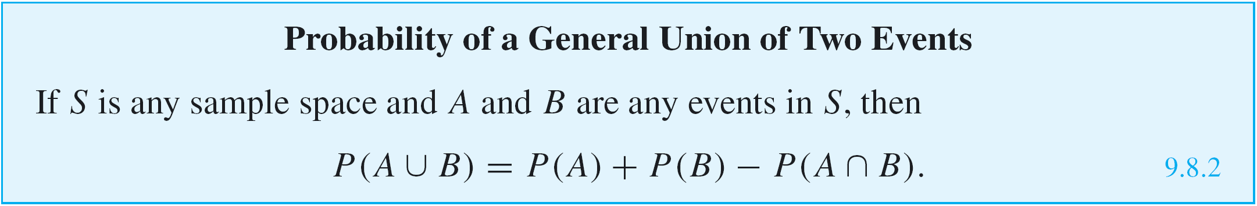
Example 3 – The Probability of a General Union of Two Events
Follow the steps outlined in parts (a) and (b) below to prove the following formula:
In both steps, suppose that A and B are any events in a sample space S.
a. Show that A ∪ B is a disjoint union of the following sets:
A – (A ∩ B), B – (A ∩ B), and A ∩ B.

Slide 9
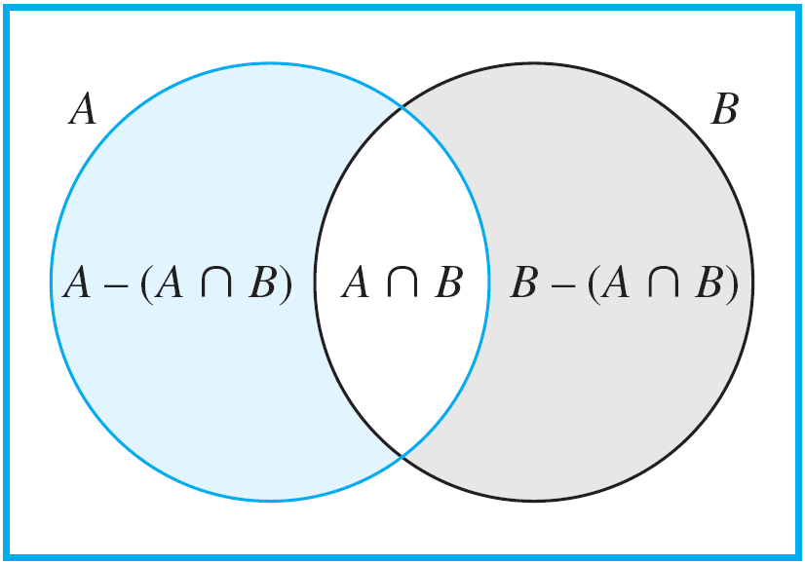
Example 3 – The Probability of a General Union of Two Events
cont’d
b. Prove that for any events U and V in a sample space S, if U ⊆ V then P(V – U) = P(V) – P(U). Use this result and the result of part (a) to finish the proof of the formula.
Solution:
a. Refer to Figure 9.8.1 as you read
the following explanation.
Elements in the set A – (A ∩ B)
are in the region shaded blue,
elements in B – (A ∩ B) are in the
region shaded gray, and elements
in A ∩ B are in the white region.
Figure 9.8.1

Slide 10
Example 3 – Solution
cont’d
Part 1: Show that
A ∪ B ⊆ (A – (A ∩ B)) ∪ (B – (A ∩ B)) ∪ (A ∩ B):
Given any element x in A ∪ B, x satisfies exactly one of the following three conditions:
(1) x ∈ A and x ∈ B
(2) x ∈ A and x ∉ B
(3) x ∈ B and x ∉ A
1. In the first case, x ∈ A ∩ B, and so
x ∈ (A – (A ∩ B)) ∪ (B – (A ∩ B)) ∪ (A ∩ B)
by definition of union.

Slide 11
Example 3 – Solution
cont’d
2. In the second case, x ∉ A ∩ B (because x ∉ B), and
so x ∈ A – (A ∩ B).
Therefore x ∈ (A – (A ∩ B)) ∪ (B – (A ∩ B)) ∪ (A ∩ B)
by definition of union.
3. In the third case, x ∉ A ∩ B (because x ∉ A), and
hence x ∈ B – (A ∩ B).
So, again, x ∈ (A – (A ∩ B)) ∪ (B – (A ∩ B)) ∪ (A ∩ B)
by definition of union.
Hence, in all three cases,
x ∈ (A – (A ∩ B)) ∪ (B – (A ∩ B)) ∪ (A ∩ B), which completes the proof of part 1.

Slide 12
Example 3 – Solution
cont’d
Moreover, since the three conditions are mutually exclusive, the three sets A – (A ∩ B), B – (A ∩ B), and
A ∩ B are mutually disjoint.
Part 2: Show that
(A – (A ∩ B)) ∪ (B – (A ∩ B)) ∪ (A ∩ B) ⊆ A ∪ B:
Suppose x is any element in
(A – (A ∩ B)) ∪ (B – (A ∩ B)) ∪ (A ∩ B).
By definition of union, x ∈ A – (A ∩ B) or x ∈ B – (A ∩ B) or x ∈ A ∩ B.

Slide 13
Example 3 – Solution
cont’d
1. In case x ∈ A – (A ∩ B), then x ∈ A and x ∉ A ∩ B by
definition of set difference.
In particular, x ∈ A and so x ∈ A ∪ B.
2. In case x ∈ B – (A ∩ B), then x ∈ B and x ∉ A ∩ B by
definition of set difference.
In particular, x ∈ B and so x ∈ A ∪ B.
3. In case x ∈ A ∩ B, then in particular, x ∈ A and
so x ∈ A ∪ B.
Hence, in all three cases, x ∈ A ∪ B, which completes
the proof of part 2.

Slide 14

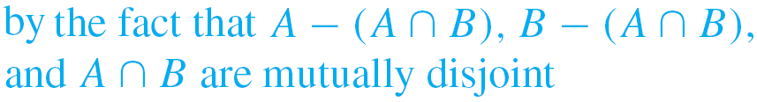

Example 3 – Solution
cont’d
b.

Slide 15
Expected Value

Slide 16
Expected Value
People who buy lottery tickets regularly often justify the practice by saying that, even though they know that on average they will lose money, they are hoping for one significant gain, after which they believe they will quit playing.
Unfortunately, when people who have lost money on a string of losing lottery tickets win some or all of it back, they generally decide to keep trying their luck instead of quitting.

Slide 17
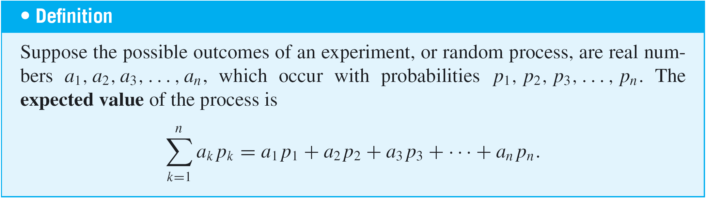
Expected Value
The technical way to say that on average a person will lose money on the lottery is to say that the expected value of playing the lottery is negative.

Slide 18
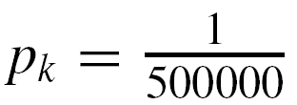
Example 5 – Expected Value of a Lottery
Suppose that 500,000 people pay $5 each to play a lottery game with the following prizes:
a grand prize of $1,000,000, 10 second prizes of $1,000 each, 1,000 third prizes of $500 each, and 10,000 fourth prizes of $10 each.
What is the expected value of a ticket?
Solution:
Each of the 500,000 lottery tickets has the same chance as any other of containing a winning lottery number, and so
for all k = 1, 2, 3, . . . , 500000.

Slide 19
Example 5 – Solution
cont’d
Let a₁, a₂, a₃, . . . , a₅₀₀₀₀₀ be the net gain for an individual ticket, where a₁ = 999995 (the net gain for the grand prize ticket, which is one million dollars minus the $5 cost of the winning ticket),
a₂ = a₃ = ・・・ = a₁₁ = 995 (the net gain for each of the 10 second prize tickets),
a₁₂ = a₁₃ = ・・・ = a₁₀₁₁ = 495 (the net gain for each of the 1,000 third prize tickets), and
a₁₀₁₂ = a₁₀₁₃ = ・・・ = a₁₁₀₁₁ = 5 (the net gain for each of the 10,000 fourth prize tickets).

Slide 20
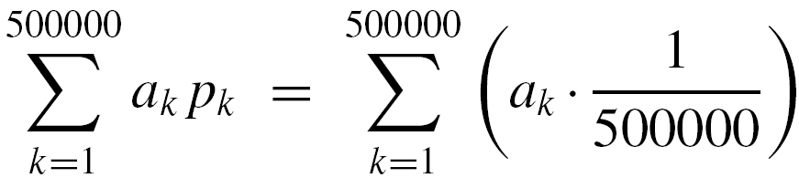

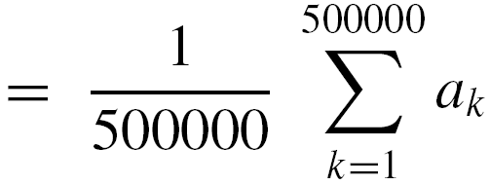

Example 5 – Solution
cont’d
Since the remaining 488,989 tickets just lose $5,
a₁₁₀₁₂ = a₁₁₀₁₃ = ・・・ = a₅₀₀₀₀₀ = –5.
The expected value of a ticket is therefore

Slide 21
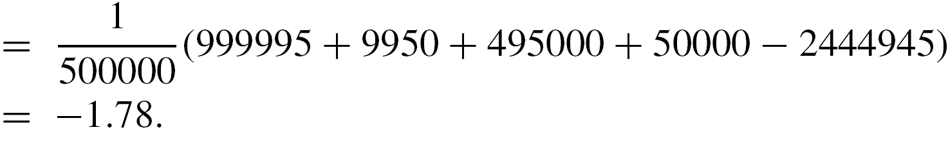
Example 5 – Solution
cont’d
In other words, a person who continues to play this lottery for a very long time will probably win some money occasionally but on average will lose $1.78 per ticket.

